Slide 1



Reduced-order models via PCA and autoencoders: PREMIERE tutorial
by César Quilodrán-Casas
March 2021

Slide 2

Outline
Reduced-order models and why?
Principal component analysis (PCA)
Example
Autoencoders (AE)
Example
Comparison between PCA and AE
Application to CFD

Slide 3
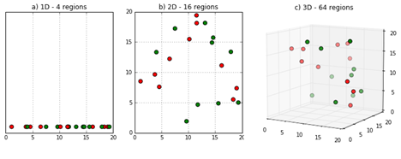
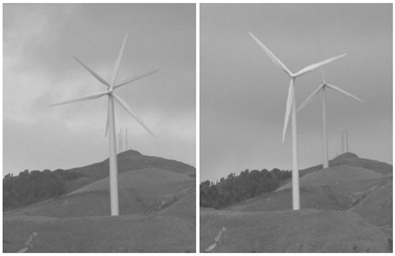
Reduced-order models (ROMs) and why?
The curse of dimensionality
Low-dimensional solutions could not scale properly in higher dimensional spaces
What if we can represent them in a low-dimensional space?
Lower computational cost (and faster)
https://deepai.org/machine-learning-glossary-and-terms/curse-of-dimensionality

Slide 4
Principal Component Analysis (PCA)
Invented by Karl Pearson in 1901, and further developed by Harold Hotelling in 1930s
Also known as:
Karnuhen-Loeve (KLT) in Signal Processing
Hotelling transform in MQC
Proper Orthogonal Decomposition (POD) in Mechanical Engineering
Singular Value Decomposition (SVD)
Empirical Orthogonal Functions (EOF) in Meteorological Science (the one I’m used to)
Etc

Slide 5
Principal Component Analysis (PCA)
Applications of PCA include:
Dimension reduction
Tool for exploratory data analysis
Visualisation of high-dimensional data
Feature selection
Noise filtering

Slide 6
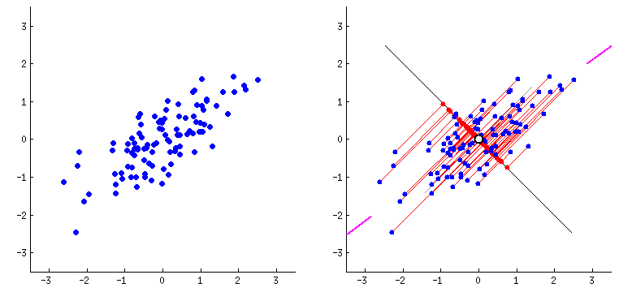
Principal Component Analysis (PCA)
Principal component analysis (PCA) simplifies the complexity in high-dimensional data while retaining trends and patterns (Lever et al., 2017)
Orthogonal linear transformation of data to a new coordinate system.
The i^{th} greatest variance lies on the i^{th} coordinate.
The aim is to find the linear combination of all the variables that explains maximum variance.
Goal: Finding the best summary of the data using a limited number of PCs.
Linear representation
Could be loss-less
https://medium.com/analytics-vidhya/dimensionality-reduction-principal-component-analysis-d1402b58feb1

Slide 7
Principal Component Analysis (PCA)
Steps:
Standardise the data
Calculate the covariance matrix
Find eigenvalues and eigenvectors of the covariance matrix
Plot the eigenvectors (Principal components)

Slide 8
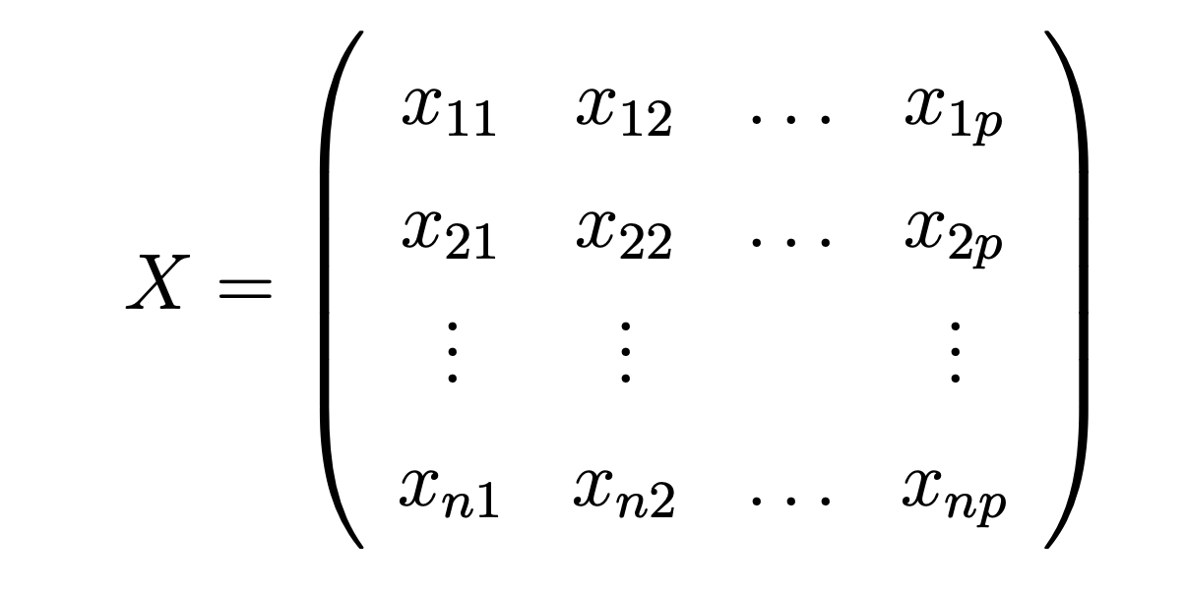
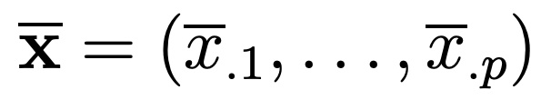

Principal Component Analysis (PCA)

Slide 9
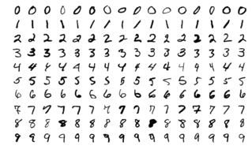
PCA example with MNIST
https://colab.research.google.com/drive/1suLdXx7b_kq027TsRHhCfn0LapRdjc0D?usp=sharing
Code can also be found in https://github.com/DL-WG/ROMS-tutorial

Slide 10
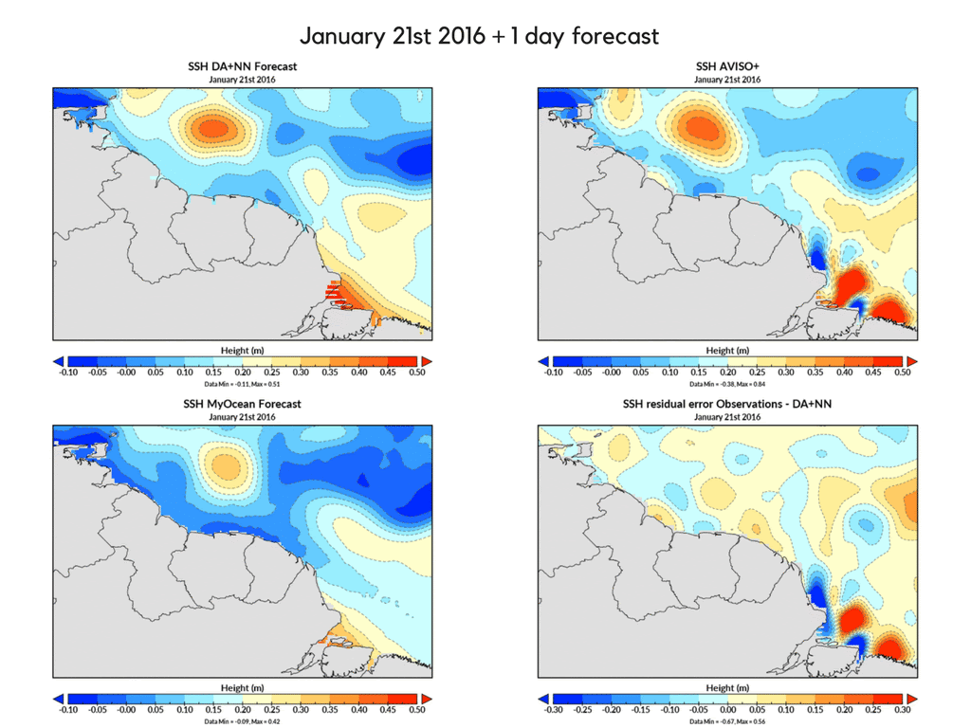
PCA example with MNIST
Quilodrán Casas, C. A. 2018. Fast ocean data assimilation and forecasting using a neural-network reduced-space regional ocean model of the north Brazil current. PhD thesis.

Slide 11
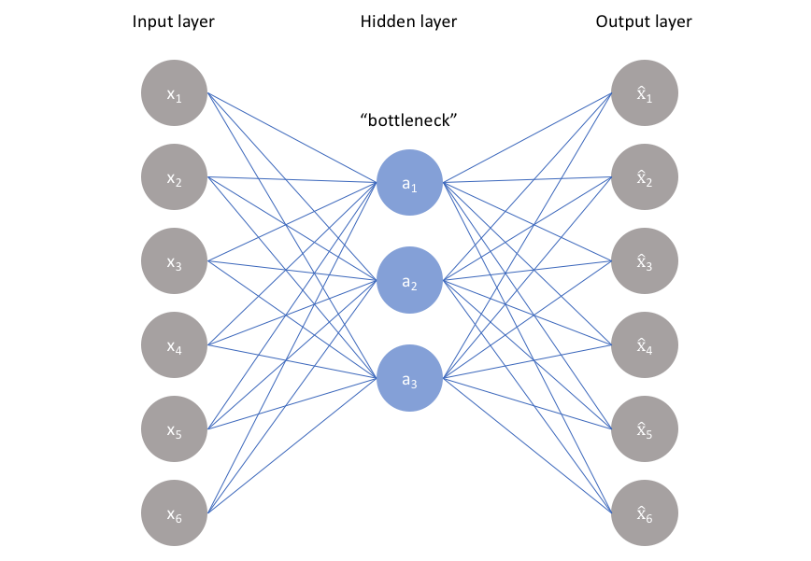
Autoencoders (AE)
AE are a type of neural network
Attempts to replicate its input as closely as its output
Learns a reduced representation called the latent space (representation)
Non-linear representation
Characteristics:
Data-specific (velocity not good for tracer)
Unsupervised
Not loss-less

Slide 12
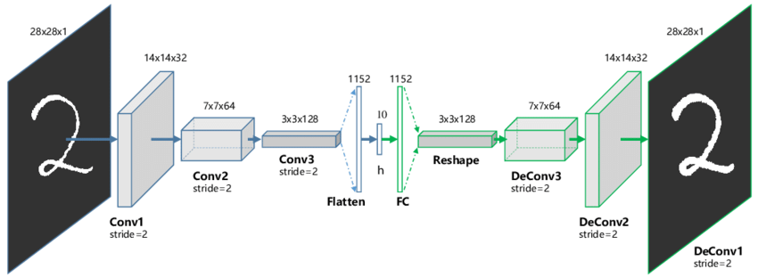
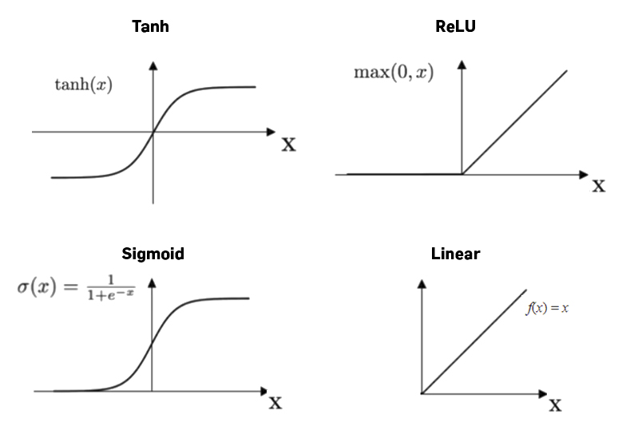
Autoencoders (AE)
Fully-connected AE
Convolutional AE
https://www.jeremyjordan.me/autoencoders/
https://www.researchgate.net/figure/The-structure-of-proposed-Convolutional-AutoEncoders-CAE-for-MNIST-In-the-middle-there_fig1_320658590

Slide 13
AE example with MNIST
https://colab.research.google.com/drive/10eD48u1WeVcTbRdA6LGcUgBUM2jy8NQy?usp=sharing
Code can also be found in https://github.com/DL-WG/ROMS-tutorial

Slide 14
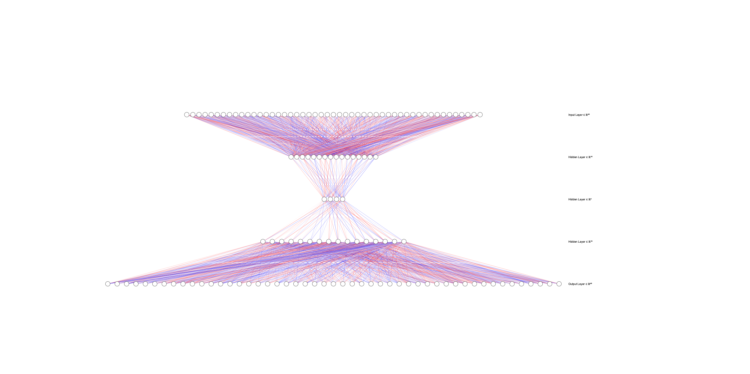
Live demo
AE architecture (scaled by 16)

Slide 15
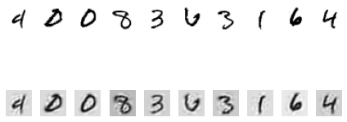
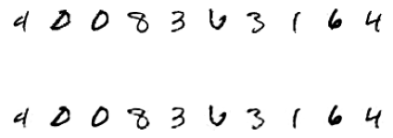
Comparison
Truncated PCA solution
AE solution

Slide 16
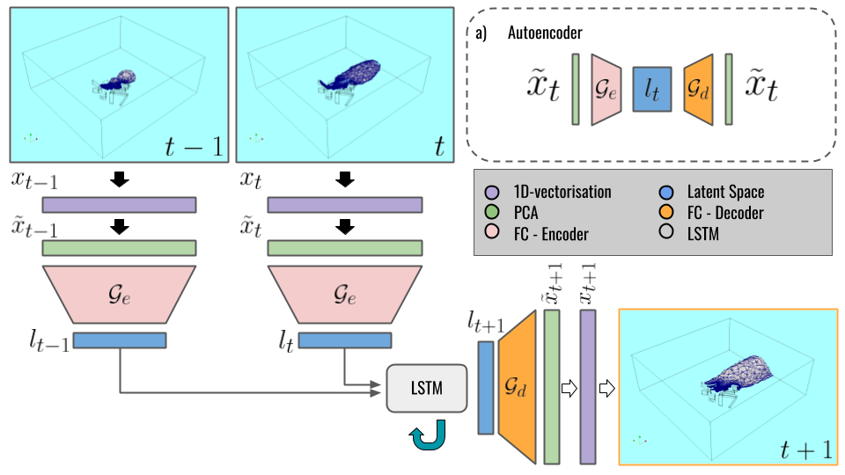
Application to CFD
Flow past the cylinder example on PyCharm
https://colab.research.google.com/drive/10ZTWmyNxcEwfYE-Ps9k_zwX6XCm1vng3?usp=sharing
Quilodrán Casas, C., Arcucci, R., Guo, Y. 2020. Urban air pollution forecasts generated from latent space representation. Integration of Deep Neural Models and Differential Equations, ICLR 2020 workshop.
Phillips, T., Heaney, C. E., Smith, P. N., & Pain, C. C. (2020). An autoencoder-based reduced-order model for eigenvalue problems with application to neutron diffusion. arXiv preprint arXiv:2008.10532.

Slide 17
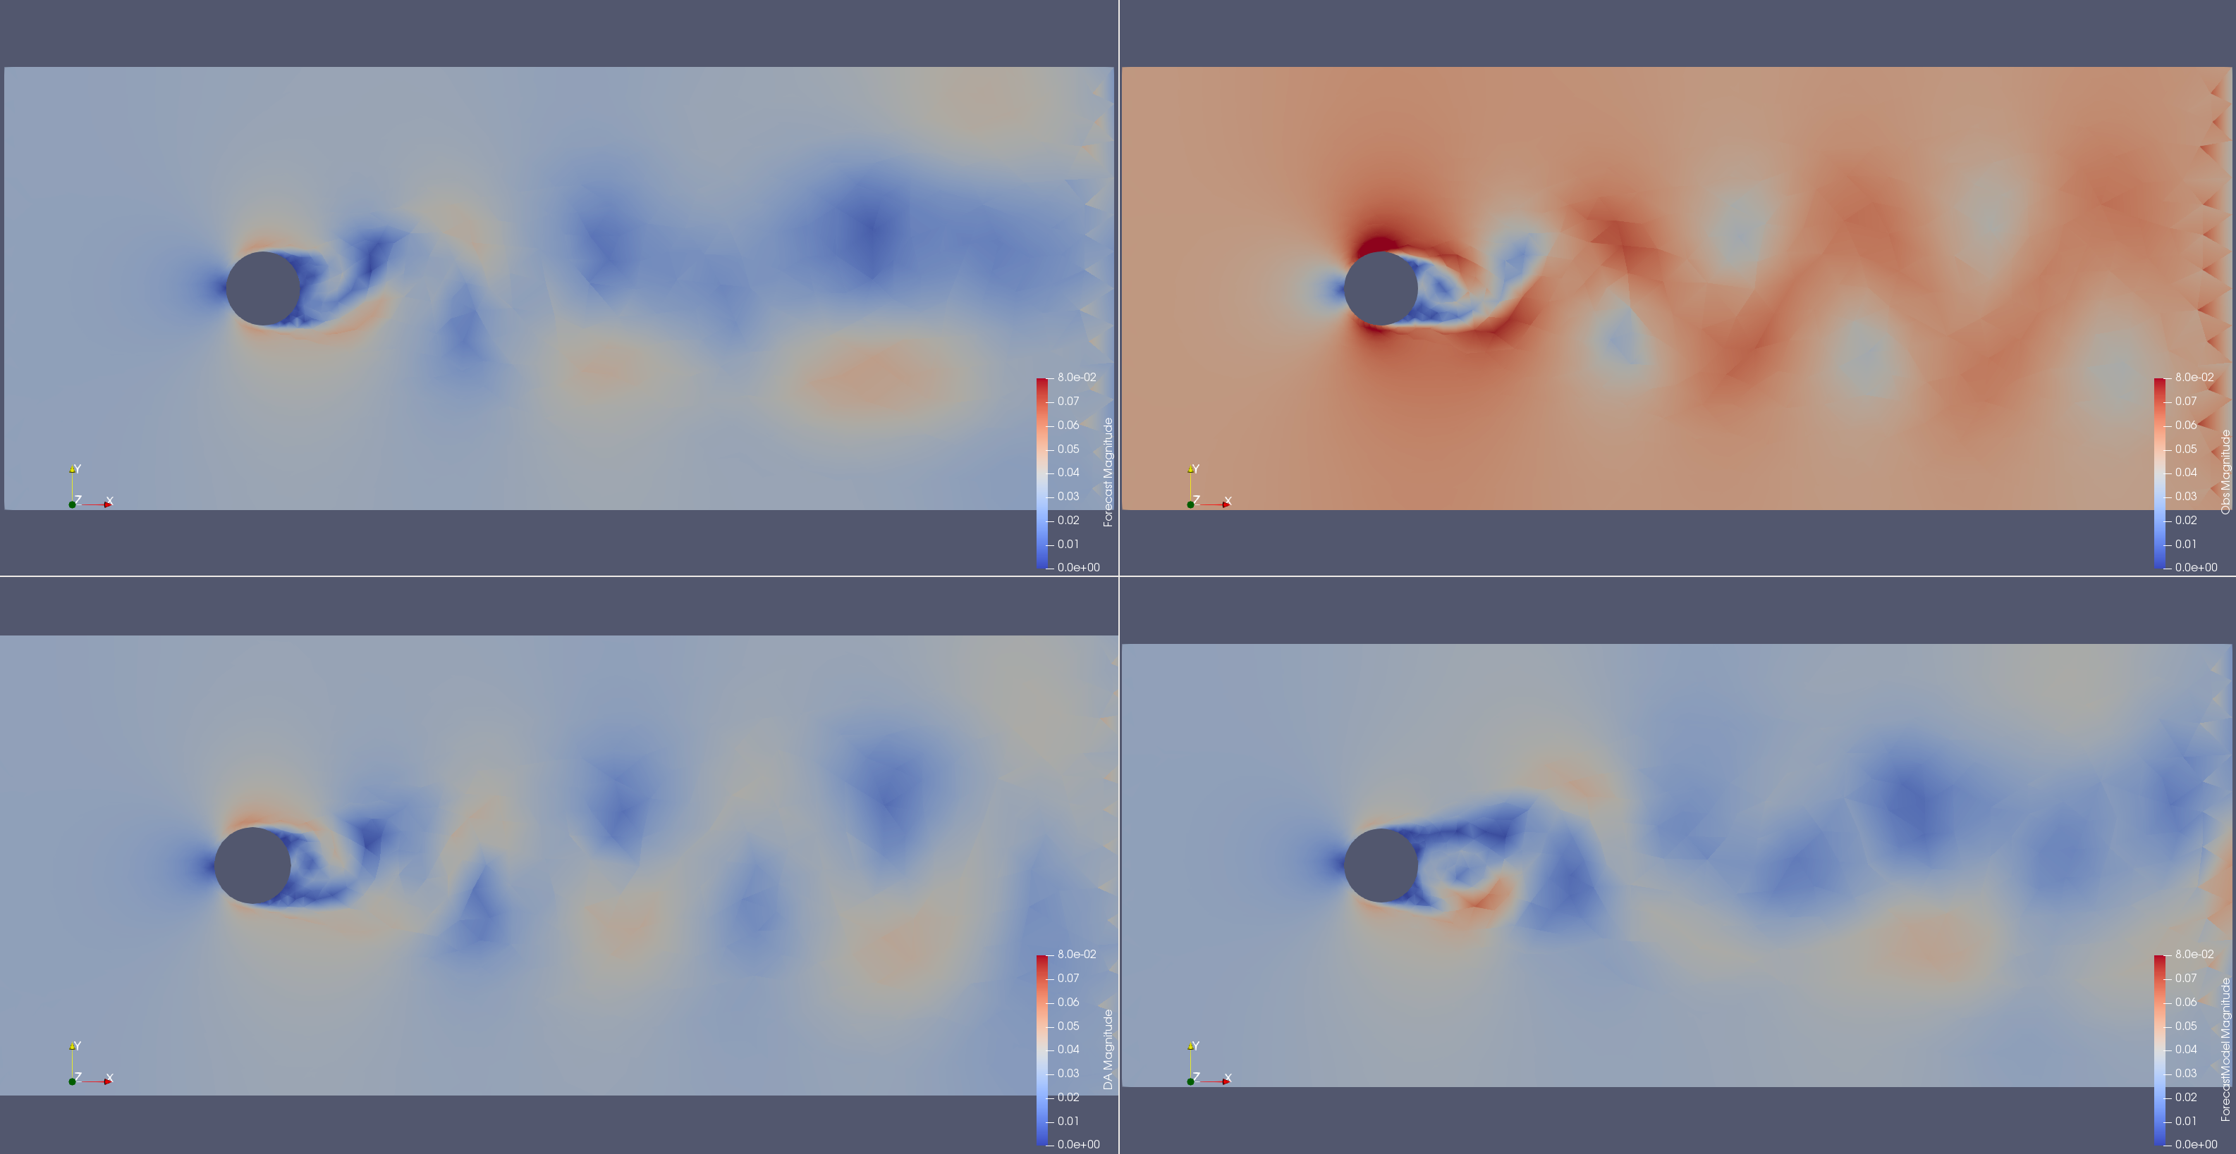
Application to CFD
Flow past the cylinder example on PyCharm
https://colab.research.google.com/drive/10ZTWmyNxcEwfYE-Ps9k_zwX6XCm1vng3?usp=sharing

Slide 18
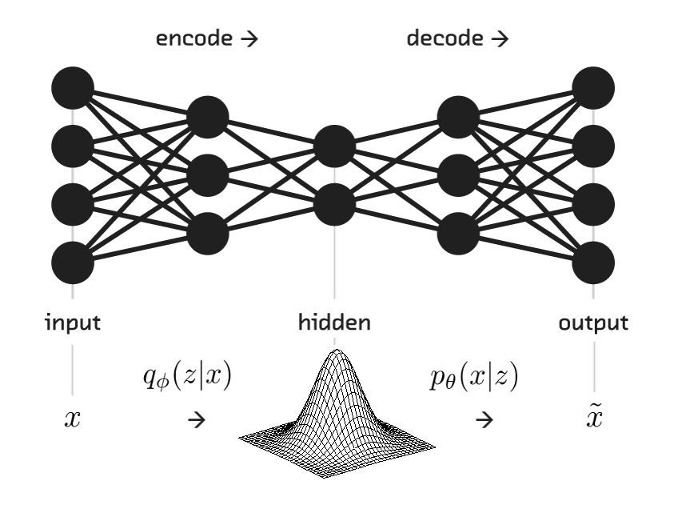
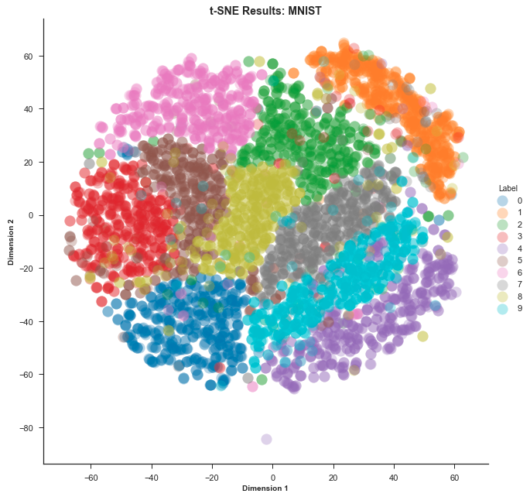
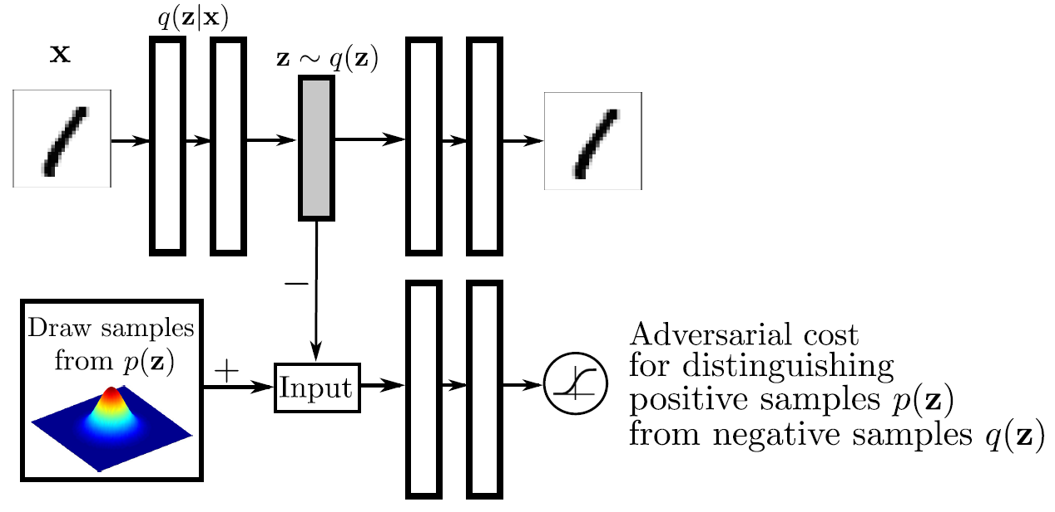
Other alternatives
t-SNE
Variational Autoencoders
Adversarial autoencoders

Slide 19
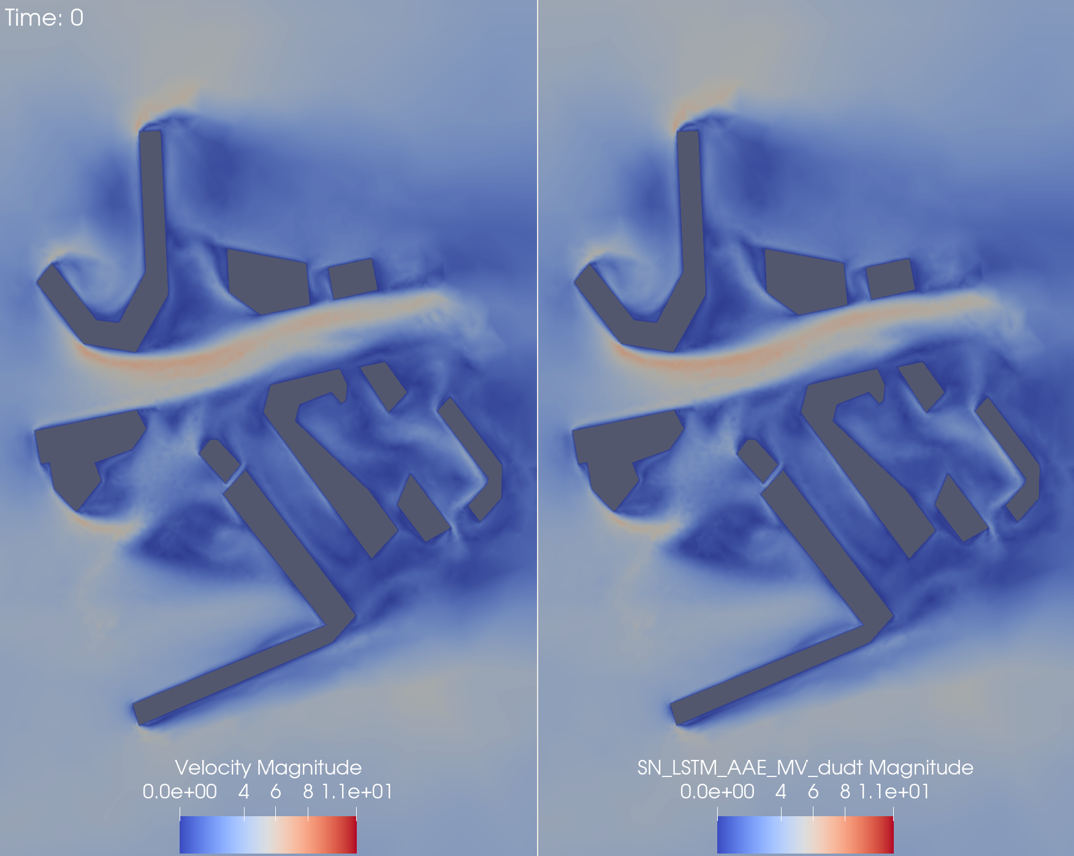
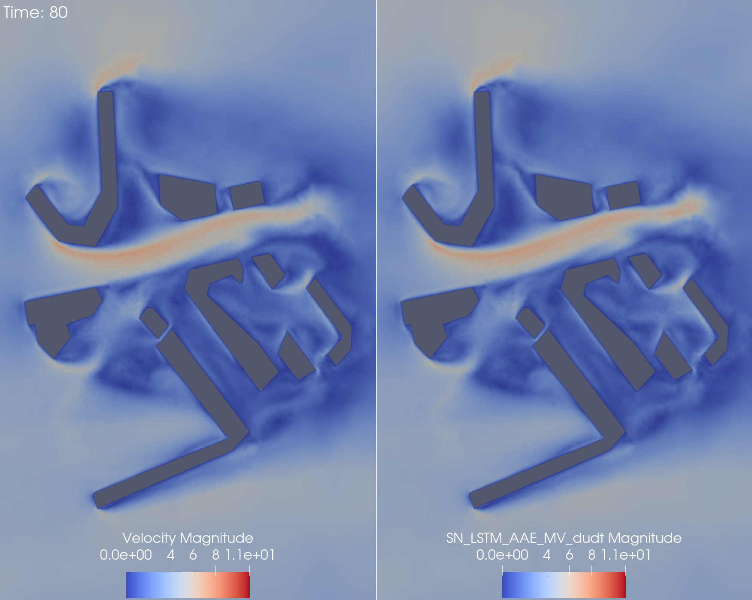
Advanced ROMs
AAE on urban air pollution
Quilodrán Casas, C., Arcucci, R., Pain, C., Guo, Y. Adversarially trained LSTMs on reduced order models of urban air pollution simulations. Third workshop on Machine Learning and the Physical Sciences (NeurIPS 2020)

Slide 20
Summary
Reduced-order models can tackle the curse of dimensionality
Useful to find a trade-off between accuracy and speed
ROMs can be a computationally low-cost solution for near real-time forecasts
ROMs are also useful to reduce the computational cost of Data Assimilation
The models presented here are general enough to be implemented on different datasets

Slide 21
Previous works
Quilodran Casas, C., Arcucci, R., Pain, C. Guo, Y. 2021. PC-based adversarial autoencoders and adversarial LSTM for improved forecasts of urban air pollution simulations. In preparation.
Quilodrán Casas, C., Arcucci, R., Pain, C., Guo, Y. Adversarially trained LSTMs on reduced order models of urban air pollution simulations. Third workshop on Machine Learning and the Physical Sciences (NeurIPS 2020)
Quilodrán Casas, C. A., Arcucci, R., Pain, C., Guo, Y. A Reduced Order Deep Data Assimilation model. 2020. Physica D: Nonlinear Phenomena. p. 132615.
Quilodrán Casas, C., Arcucci, R., Guo, Y. 2020. Urban air pollution forecasts generated from latent space representation. Integration of Deep Neural Models and Differential Equations, ICLR 2020 workshop.
Quilodrán Casas, C. A. 2018. Fast ocean data assimilation and forecasting using a neural-network reduced-space regional ocean model of the north Brazil current. PhD thesis.

Slide 22
Thank You

